Slide 1
Loops
While Loop | Do-While Loop | For Loop
Notes:
Welcome to our lecture on some more Loop. In this lecture we will go through while loop, do while loop, and for loop. Let’s start our lecture.

Slide 2

While Loop
Definition: A while loop is a control structure that repeatedly executes a set of statements (loop body) as long as the condition is true.
Condition Check: The condition is evaluated before the loop body runs; if false, the loop terminates immediately.
Purpose: Used for general-purpose looping where the number of iterations depends on a condition rather than being predetermined.
Notes:
The while loop is a control structure used to repeatedly execute a block of code as long as its condition remains true. Before running the loop body, the condition is evaluated. If the condition is false, the loop stops immediately. While loops are ideal for scenarios where the number of iterations is not fixed and depends on a condition being met during execution.

Slide 3
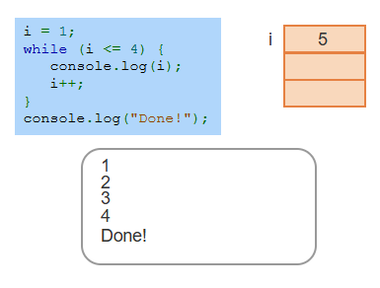
Example
Notes:
This example demonstrates a while loop. The loop starts with the variable i set to 1. The condition checks if i is less than or equal to 4. If true, it prints the current value of i, increments i by 1, and repeats. Once i exceeds 4, the condition becomes false, and the loop ends. Finally, the program prints Done. The loop executes four times, outputting the values 1 through 4.

Slide 4
Do-While Loop
Definition: A do-while loop executes the loop body at least once before evaluating the condition.
Execution Flow: The condition is checked after the loop body, and the loop continues repeating until the condition is false.
Purpose: Used when the loop body must execute at least once, regardless of the initial condition.
Notes:
Next comes do-while loop which ensures the loop body executes at least once before checking the condition. After the body runs, the condition is evaluated to decide if the loop should continue. This makes it different from a while loop where the condition is checked first. Do-while loops are useful when the body must run at least once, such as for user input or initial setup, regardless of the starting condition.

Slide 5
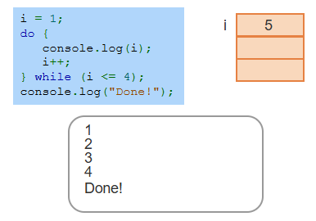
Example
Notes:
This example shows a do-while loop. The variable i starts at 1, and the loop body executes immediately, printing the value of i and incrementing it by 1. Afterward, the condition is checked. If i is less than or equal to 4, the loop repeats. Once i becomes 5, the condition is false, and the loop ends. Finally, Done is printed. This ensures the loop runs at least once, regardless of the initial condition.

Slide 6
For Loop
Structure: A for loop combines initialization, condition, and update expressions at the top of the loop for concise control.
Execution Flow: It initializes the loop variable, checks the condition, executes the loop body if true, then updates the loop variable and rechecks the condition.
Purpose: Ideal for loops with a predetermined number of iterations or when managing loop variables explicitly.
Notes:
Finally, we will discuss for loop which is a control structure that organizes initialization, condition, and update expressions at the top for concise and clear iteration. It starts by initializing the loop variable, checks the condition, and runs the loop body if true. After the body executes, the loop variable is updated, and the condition is rechecked. This structure is ideal for loops with a known number of iterations or controlled steps.

Slide 7
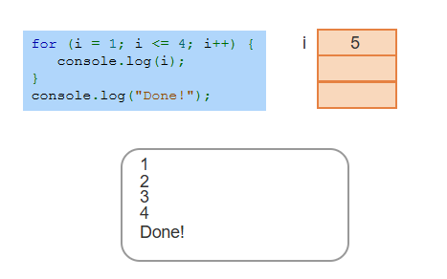
Example
Notes:
This example demonstrates a for loop. The loop starts by initializing i to 1, then checks if i is less than or equal to 4. If true, the loop body runs, printing the value of i. Afterward, i is incremented by 1. This process repeats until I exceeds 4, at which point the loop ends. Finally, Done is printed. The loop runs four times, outputting 1, 2, 3, and 4 in sequence. Thanks for watching the lecture.

